Slide 1
The State of Sakai
Charles Severance, Sakai PMC Chair

Slide 2
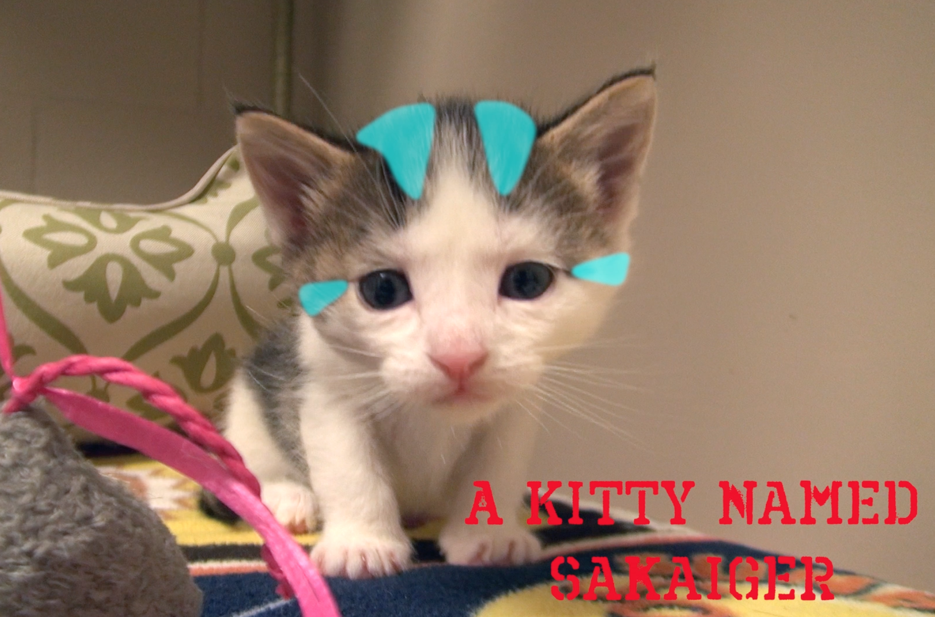

Slide 3


Slide 4
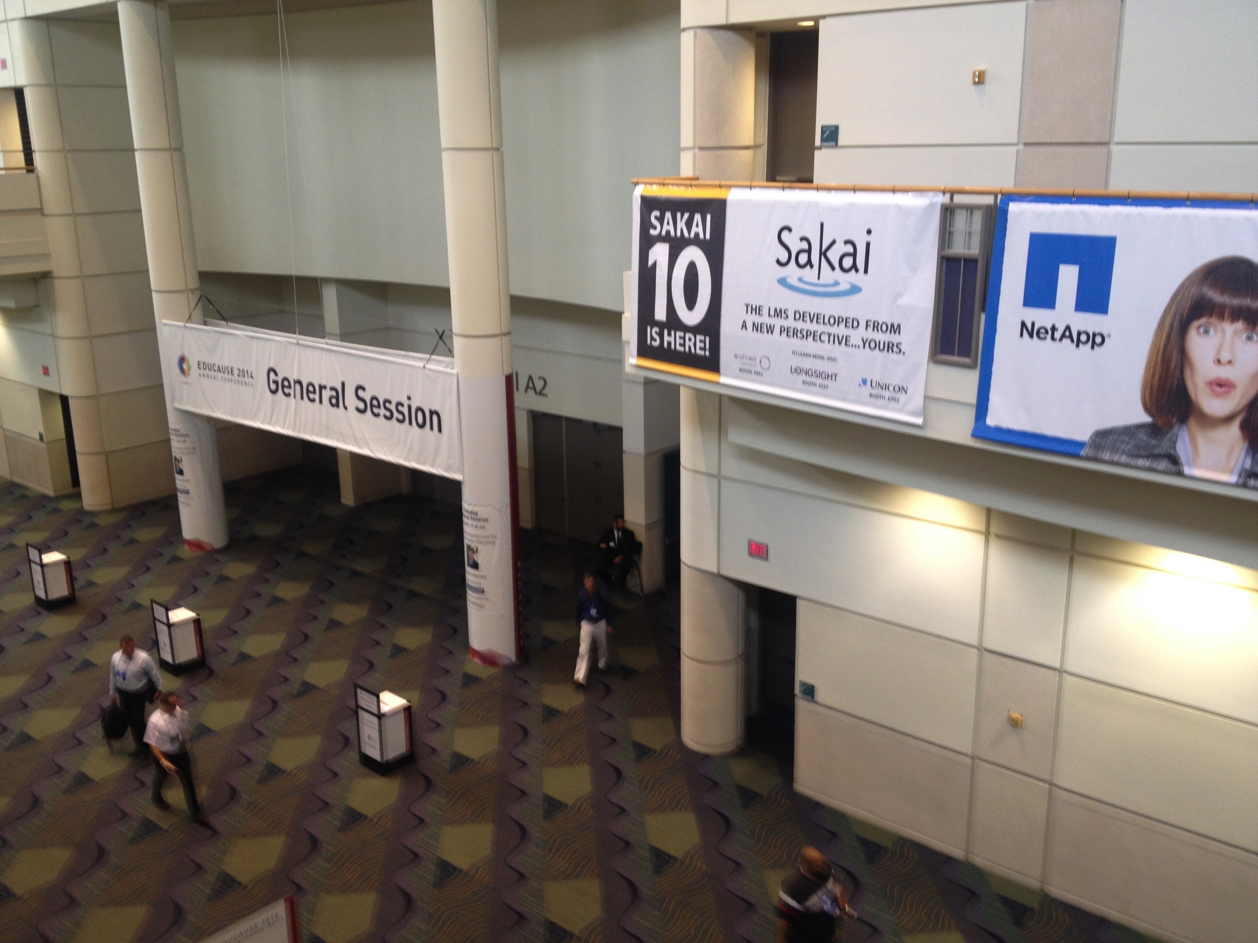

Slide 5

Core Values
Open Source
Open Community
Open Planning / Roadmap
Our "shareholders" are the adopters and users

Slide 6
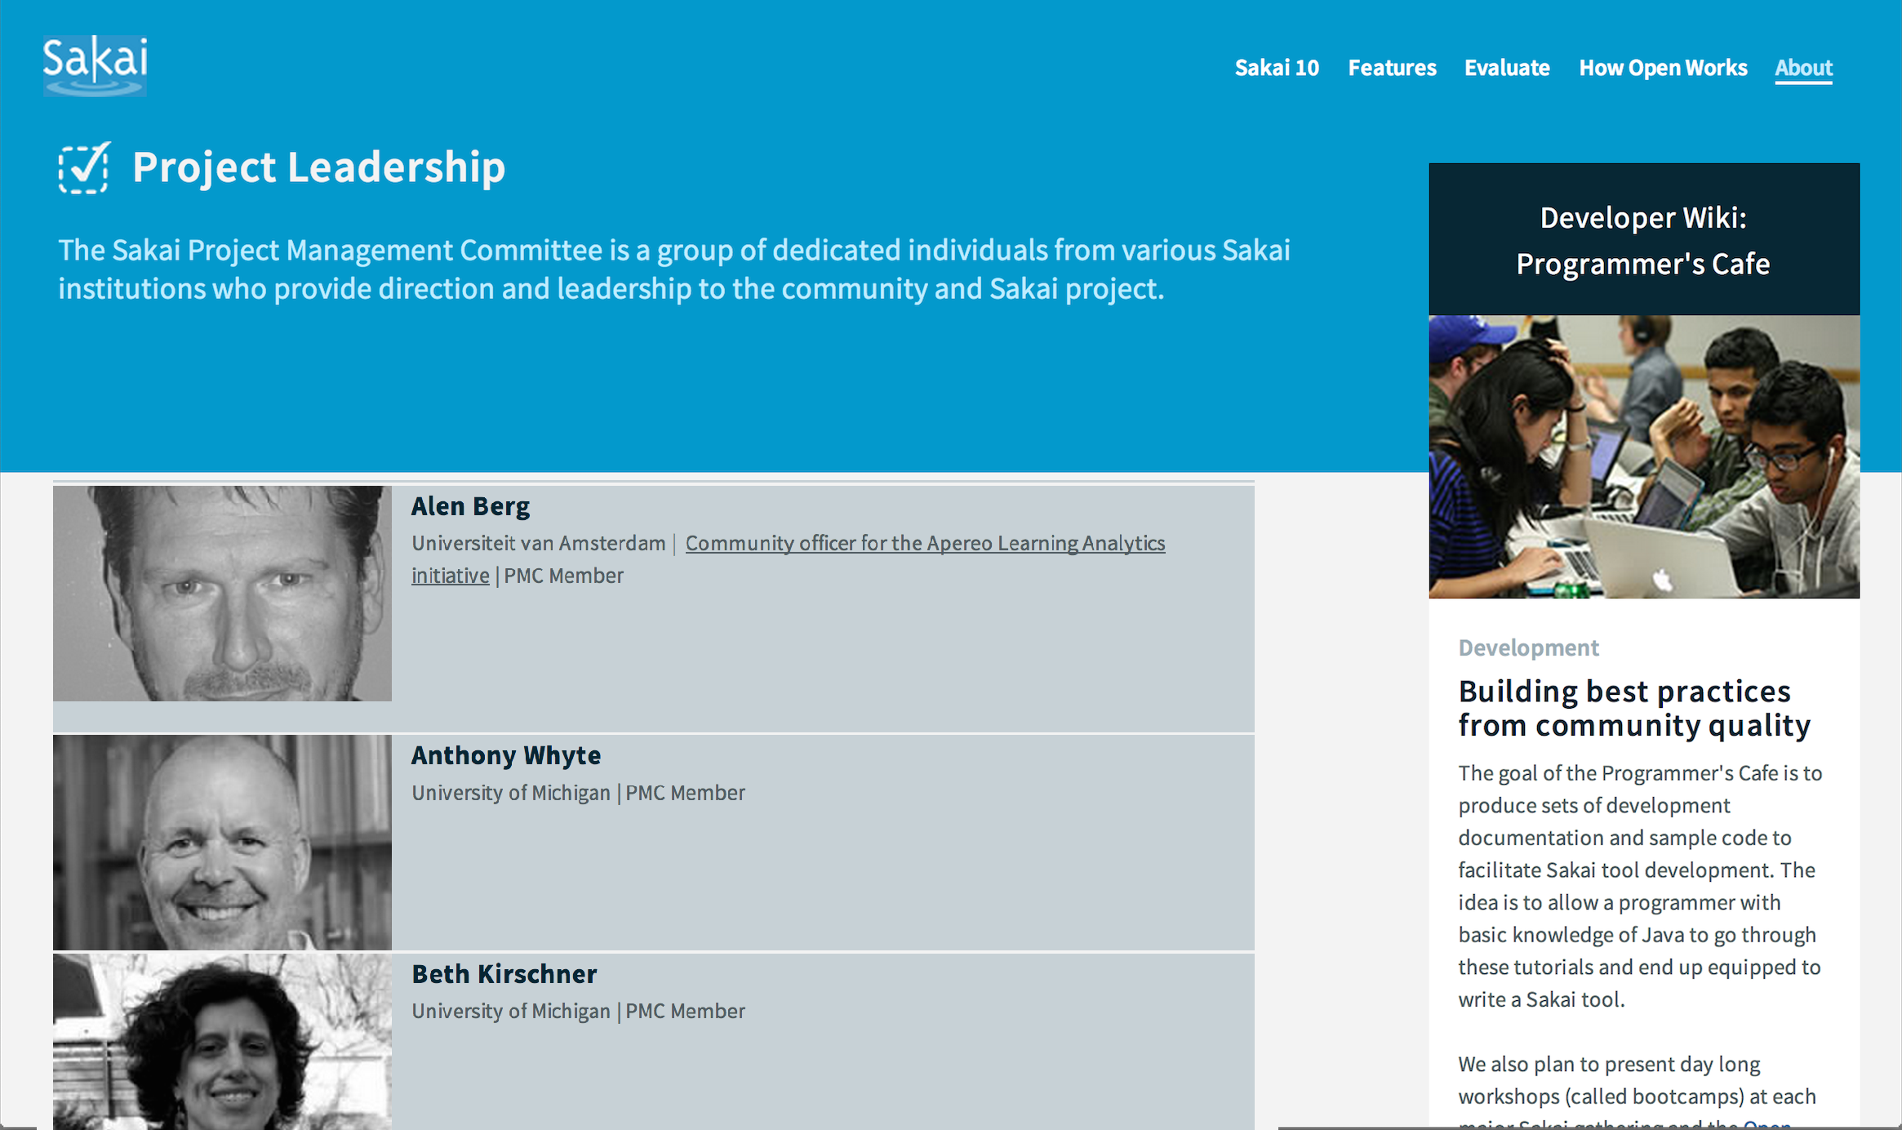

Slide 7
LMS Market
Sakai has never been about market share
5-6% of the US market
8-10% of the international market
Many schools still on old software
Angel
Pre Blackboard 9.0
Commercial competition is intensifying

Slide 8

Leadership in Standards
Leading the way in cross-LMS interoperability
Helped found most of major IMS Standards
Learning Tools Interoperability (IMS LTI)
Common Cartridge (IMS CC)
First to ship most IMS standards
Most recently IMS LTI 2.0 in Sakai 10

Slide 9

A Decade of Innovation
Sakai 2.9 – Summer 2013
Course navigation / Lesson Builder
Sakai 10 – Summer 2014
Improve cloud hosting / Many small UI Improvements
Sakai 11 – Fall 2015
Responsive design / large UI improvements

Slide 10
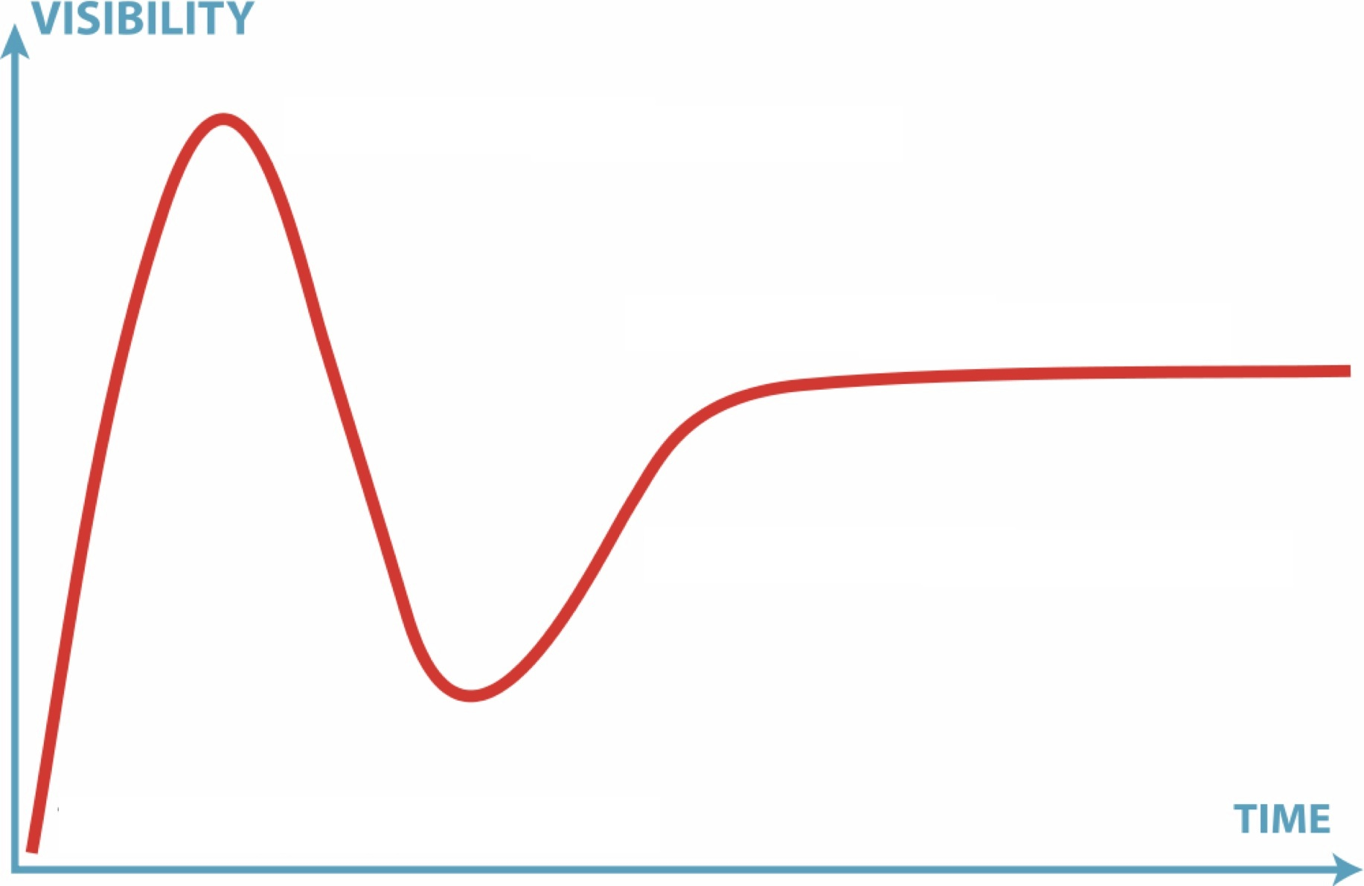

Perception Versus Reality
11
2.9
10
2.6
2.7
2.8
2.5
2.0
1.0
1.5

Slide 11
Peer Grading Assignments
Group Assignments
Help Improvements
Forums "MOOC-like"
Test and Quizzes – All HTML5 recorder
Syllabus Improvements
Improved messaging
Lesson Builder
Peer rubrics
Polls
Rich Text Editor
Audio Record HTML
Accessibility/ARIA
MathML
Grade Book Extra Credit
Drag / Drop Upload

Slide 12
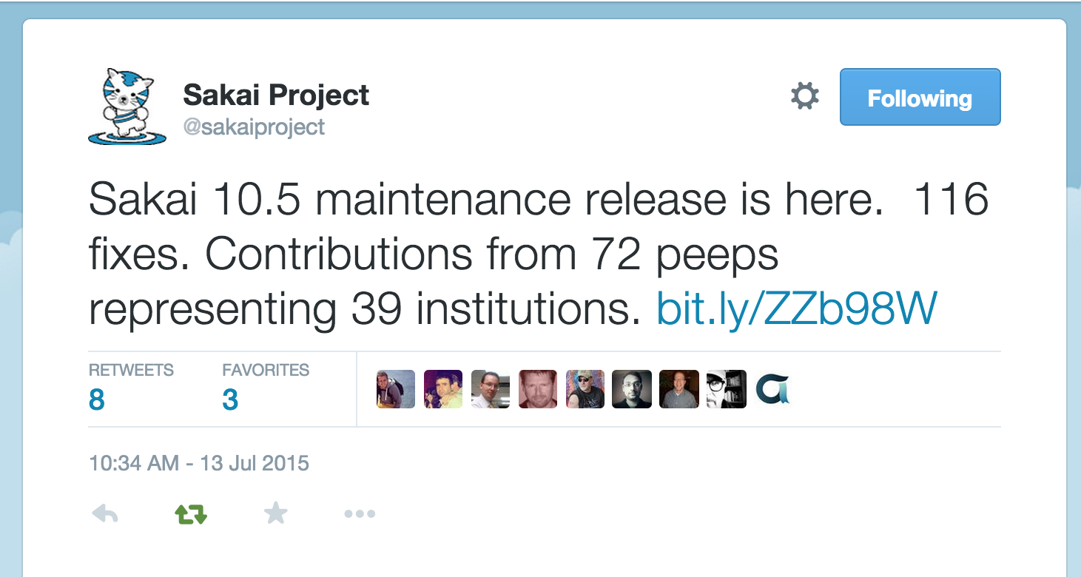

Slide 13
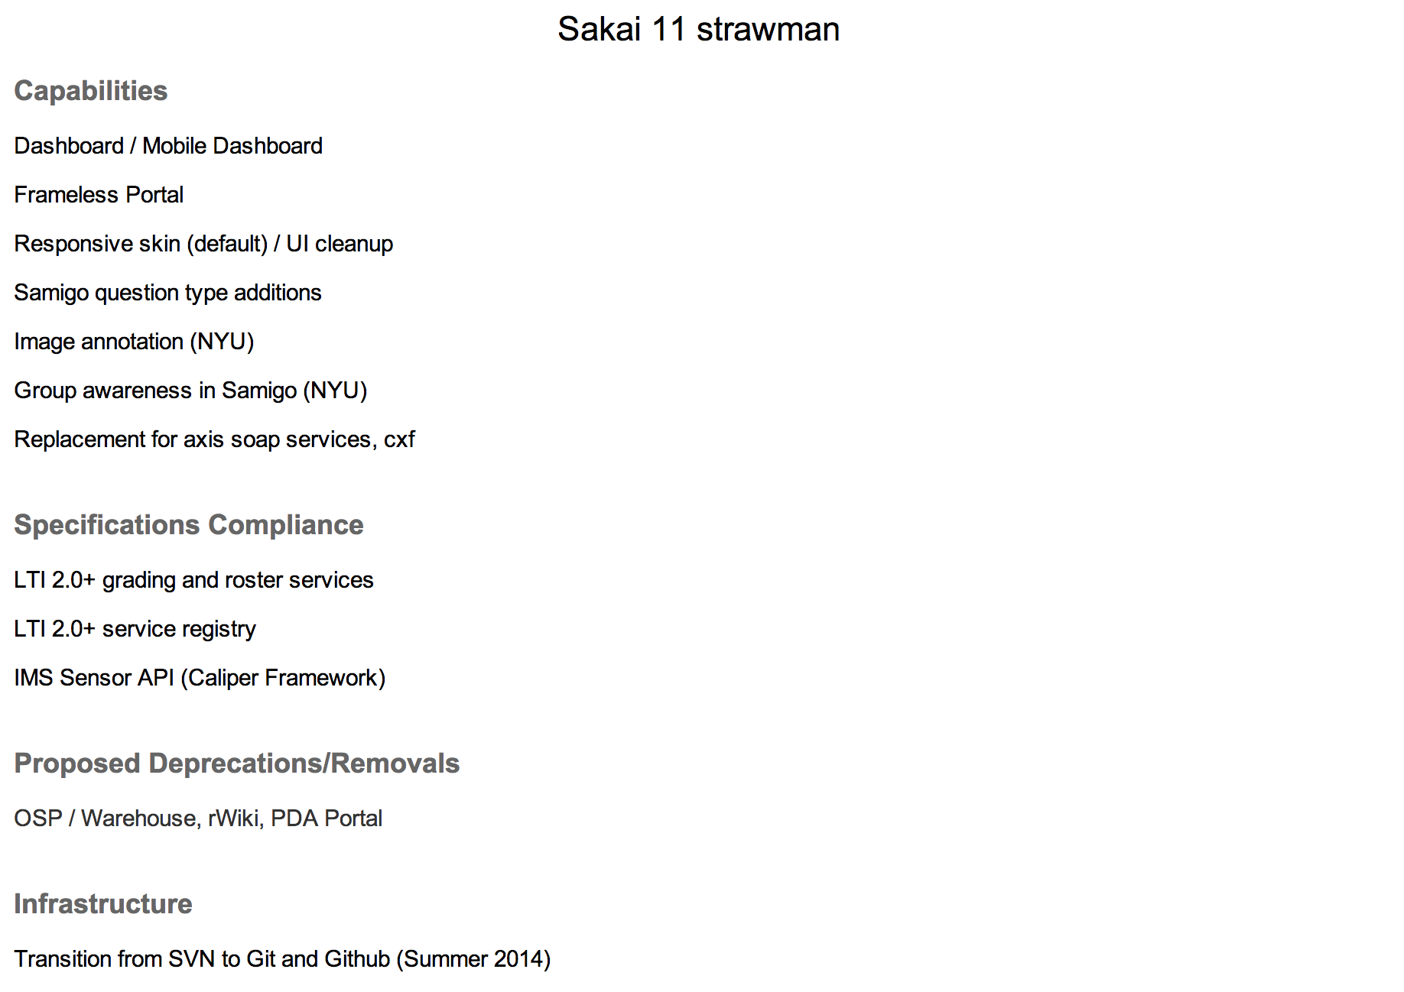
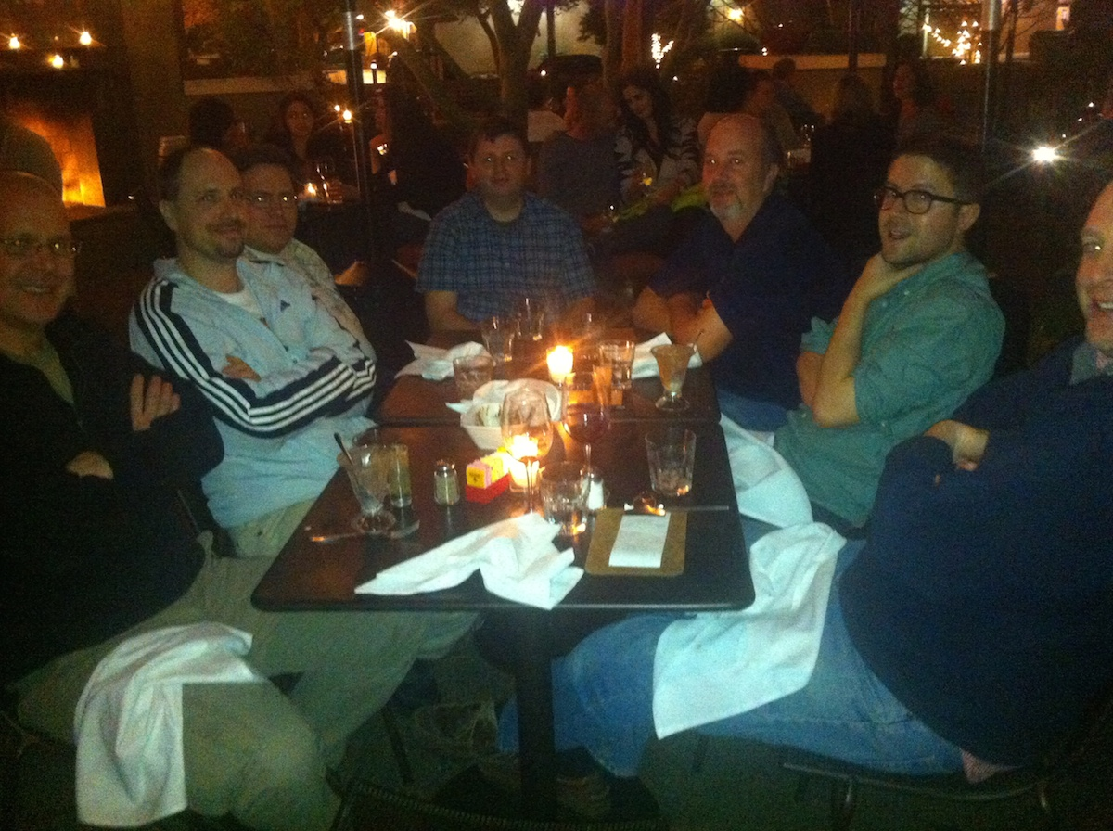
January 2014
https://confluence.sakaiproject.org/display/REL/Sakai+11+straw+man

Slide 14
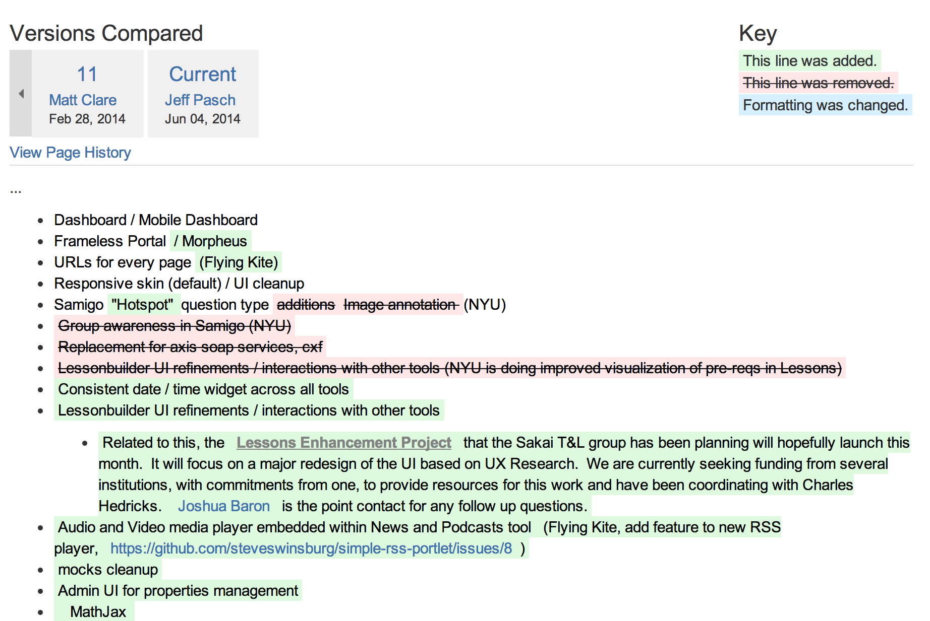
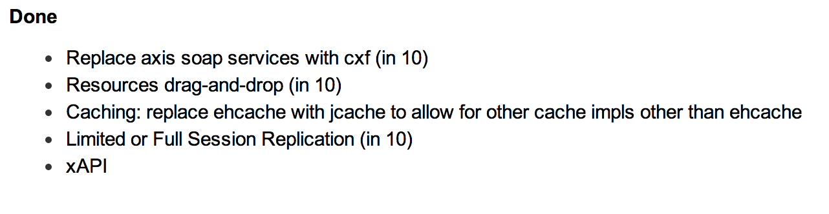
https://confluence.sakaiproject.org/display/REL/Sakai+11+straw+man

Slide 15
Sakai 11 – Significant UI/UX
Morpheus Portal is iframe-free and Responsive
NYU, Marist, Murcia
Grade book UI Redesign
Lessons UI Redesign

Slide 16
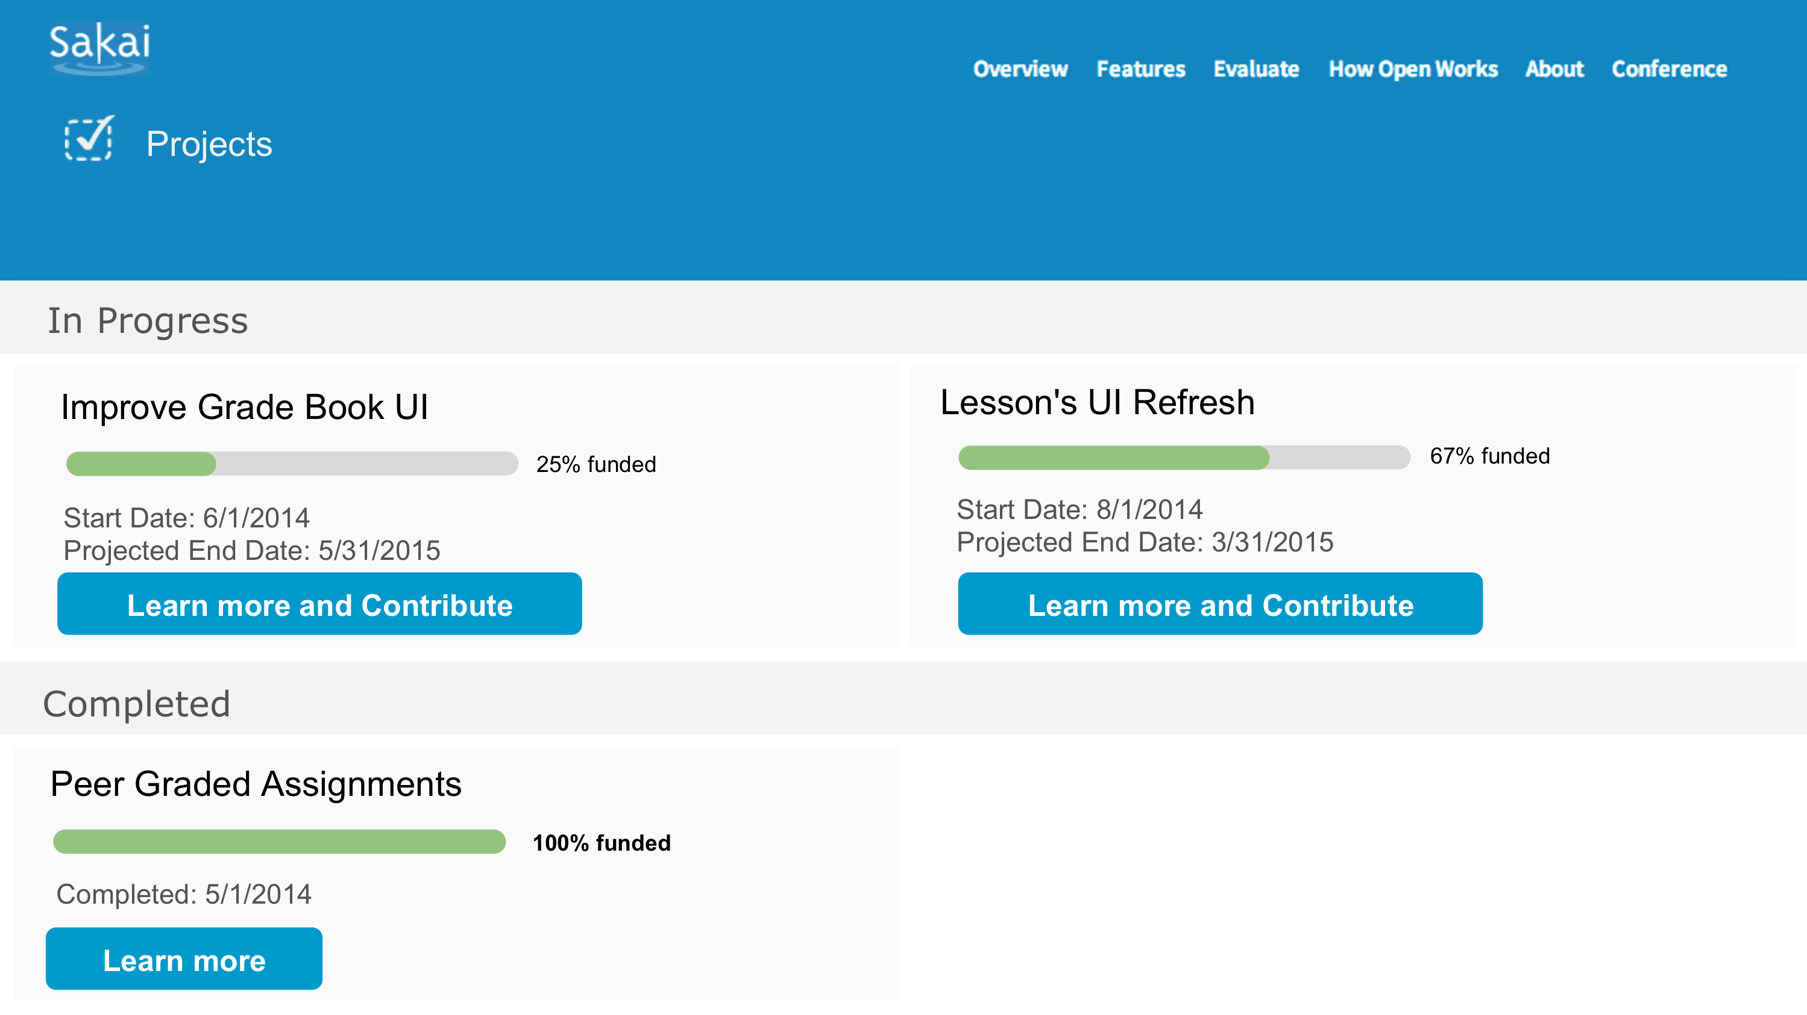
Fund Raising with a Purpose

Slide 17
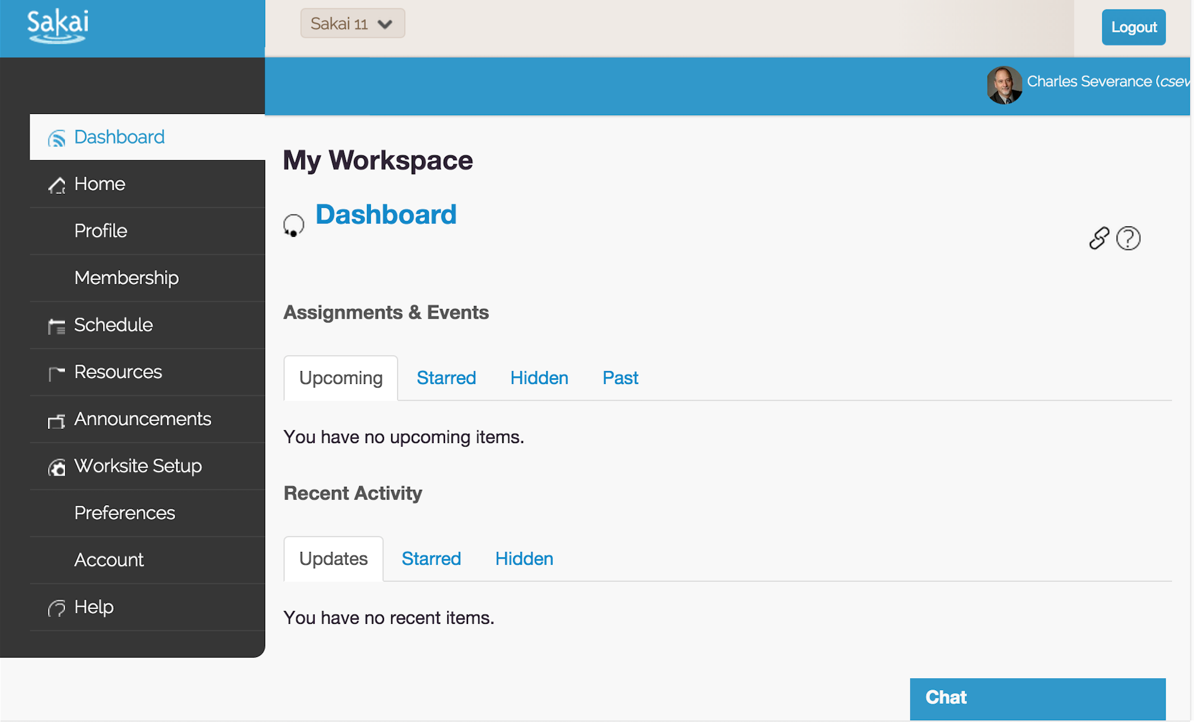

Slide 18
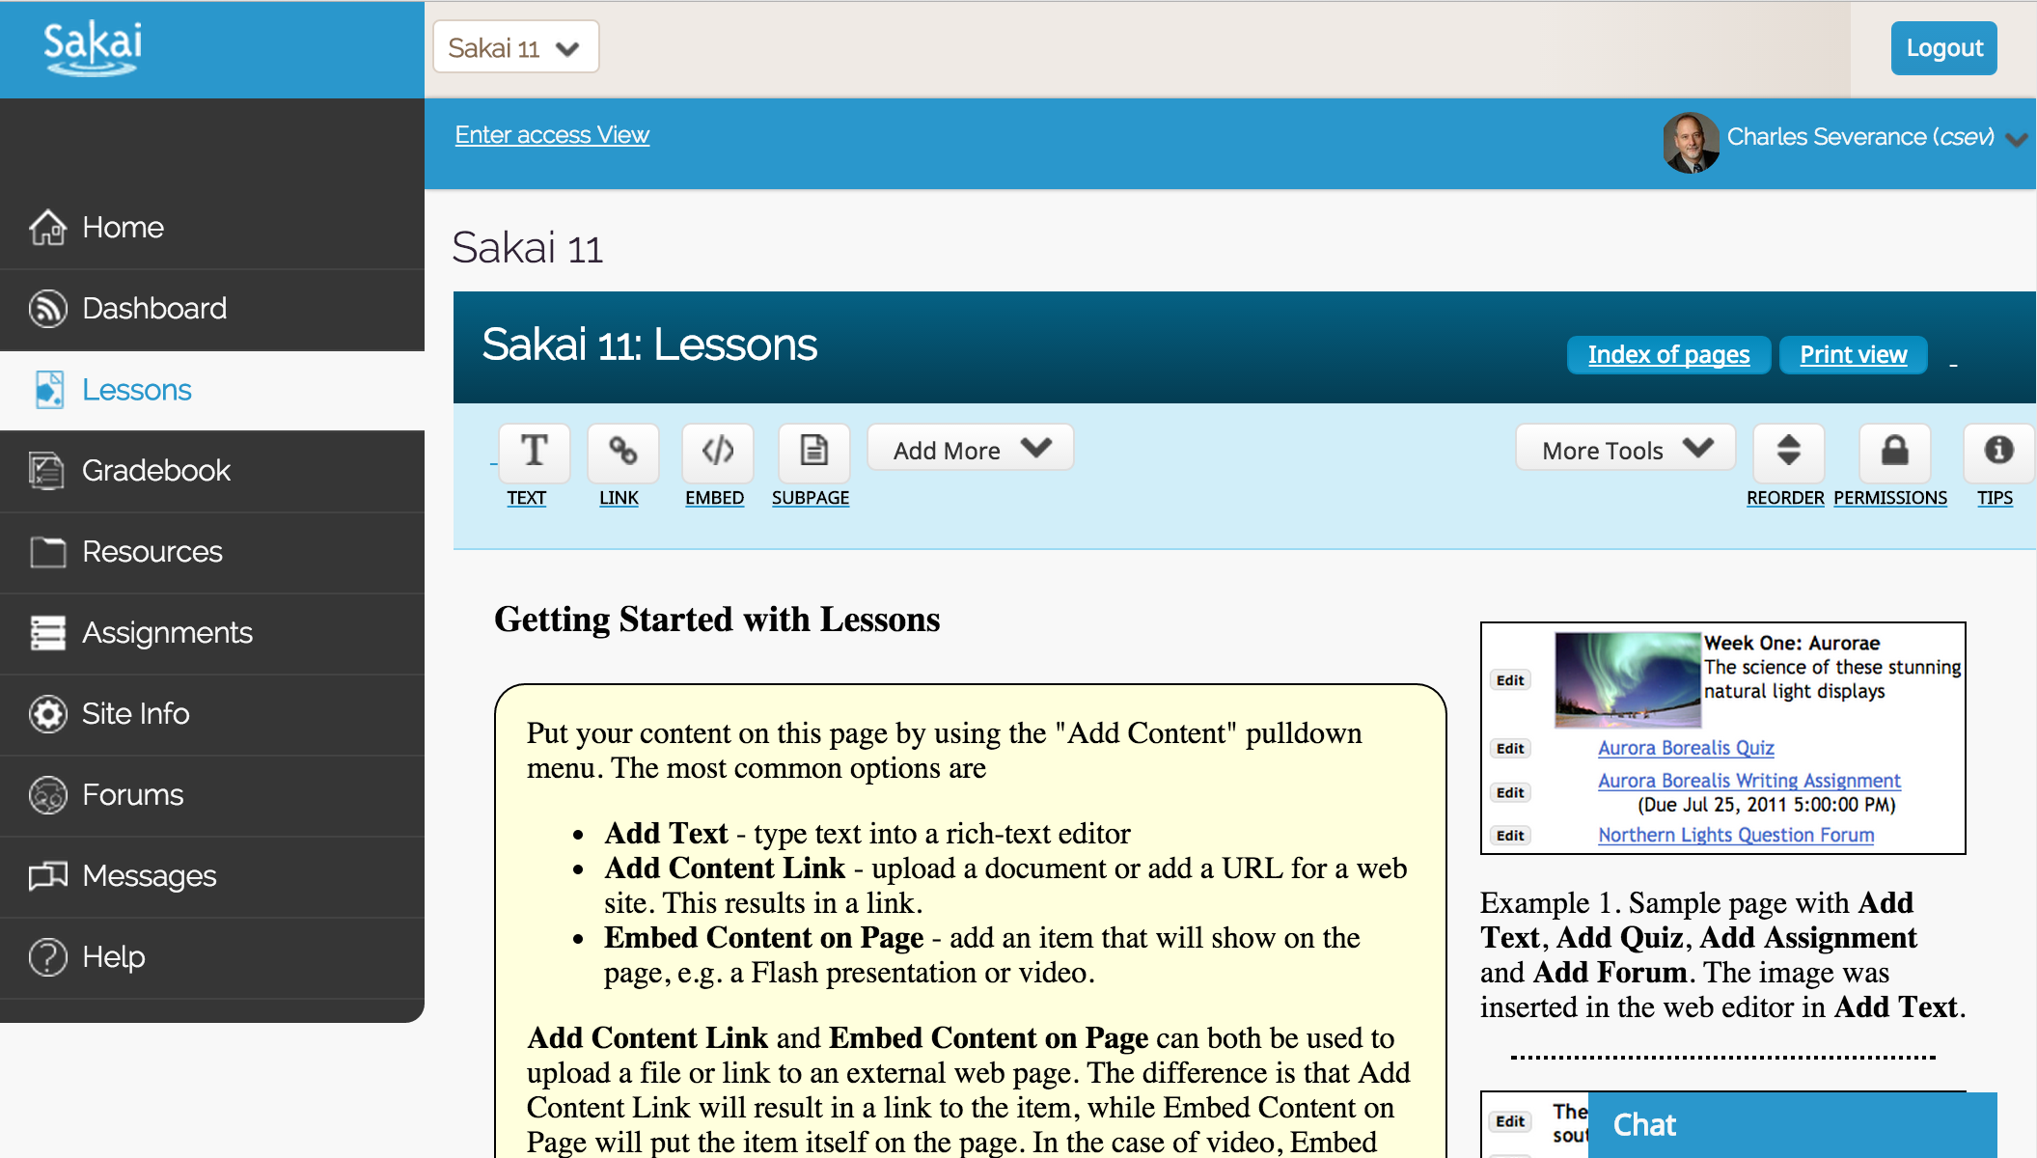

Slide 19
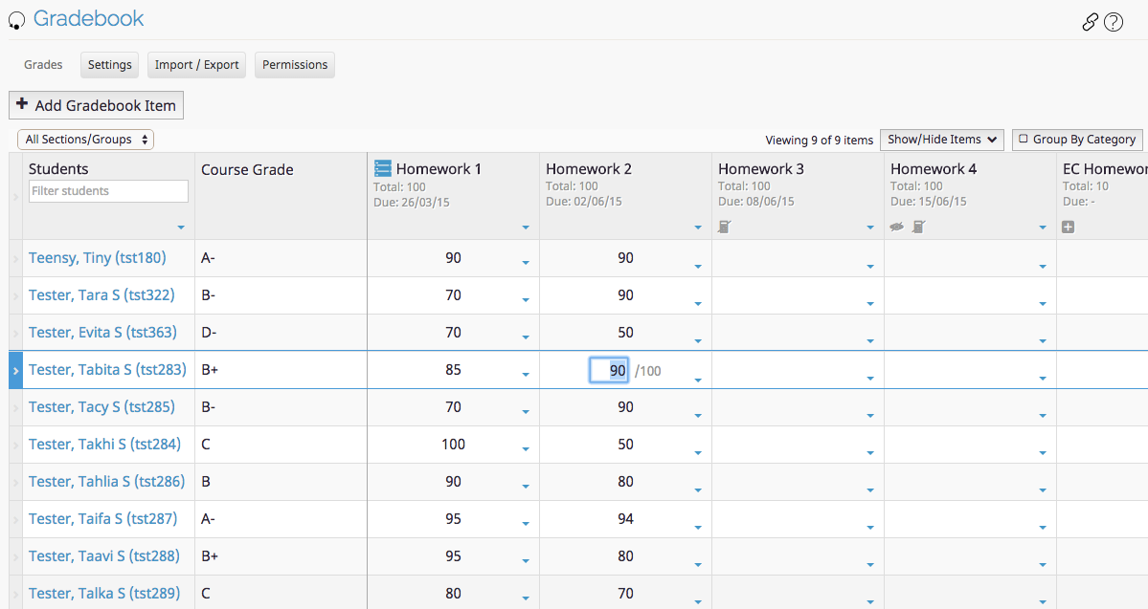

Slide 20
Sakai-11 Schedule
Late July - Sakai 11 branch cut. Code freeze / String freeze .
2015 October - RC01 (lots of testing between now and then is needed. lots of bug fixing too!)
Q4 2015 - Stretch goal - release Sakai 11

Slide 21
Community

Slide 22

Source Code Control

Slide 23
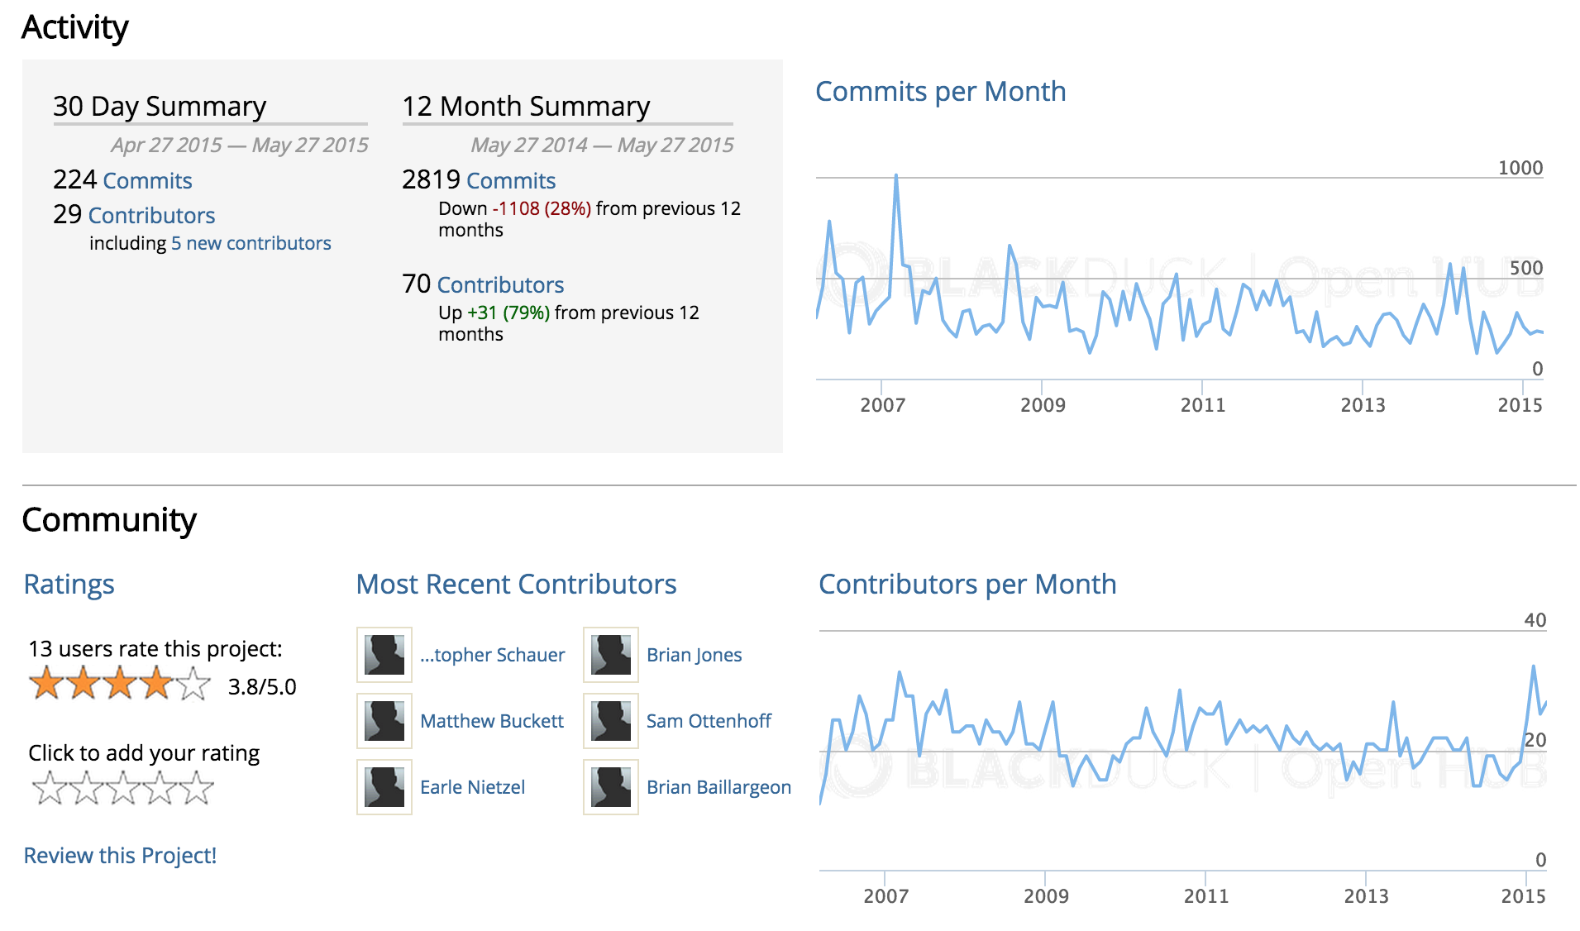
https://www.openhub.net/p/sakai

Slide 24
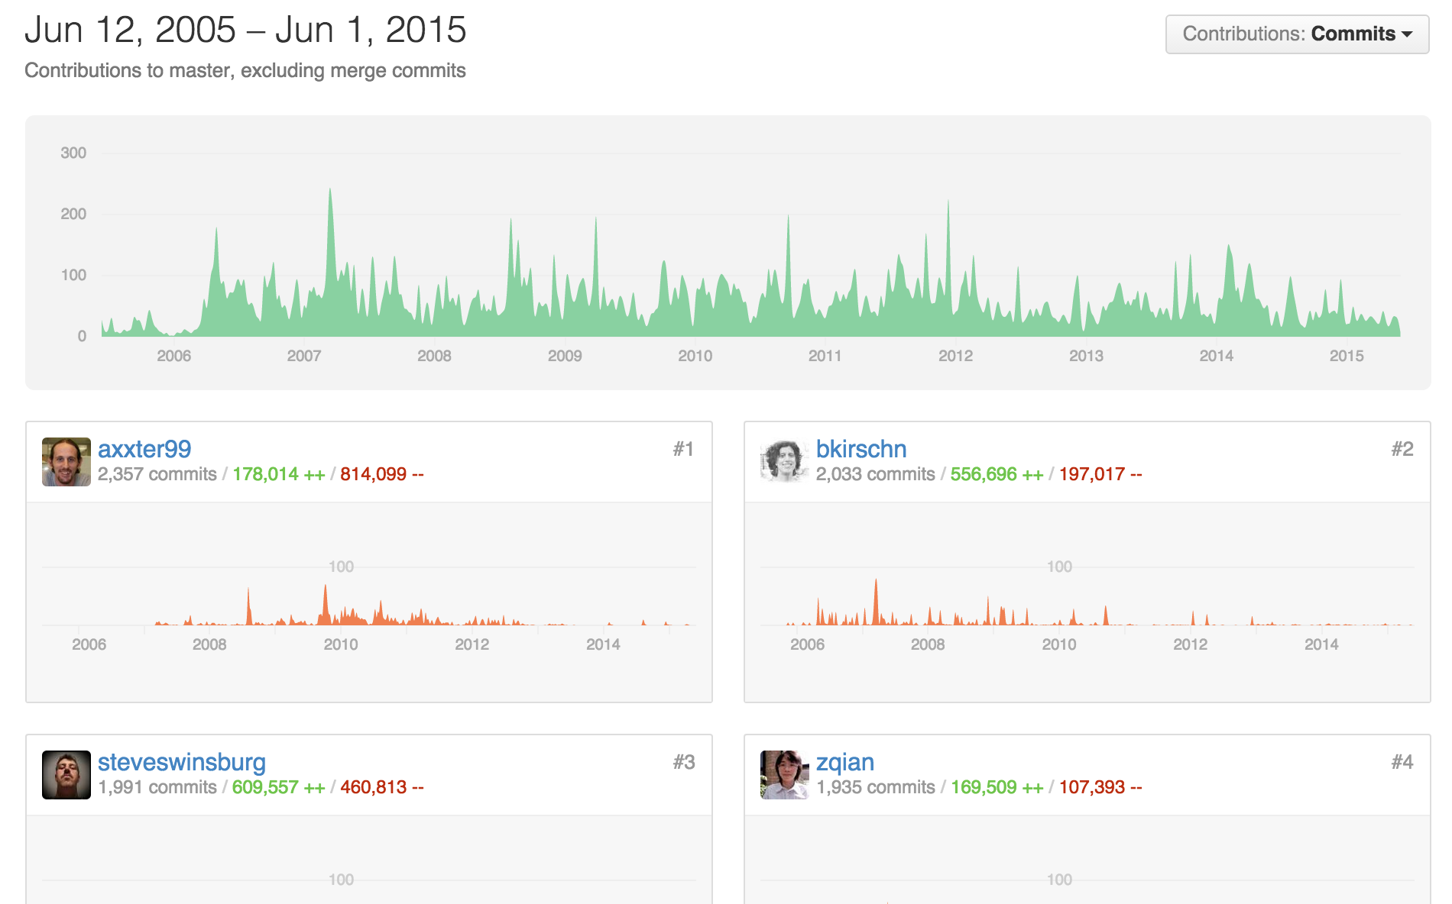
https://github.com/sakaiproject/sakai/graphs/contributors

Slide 25
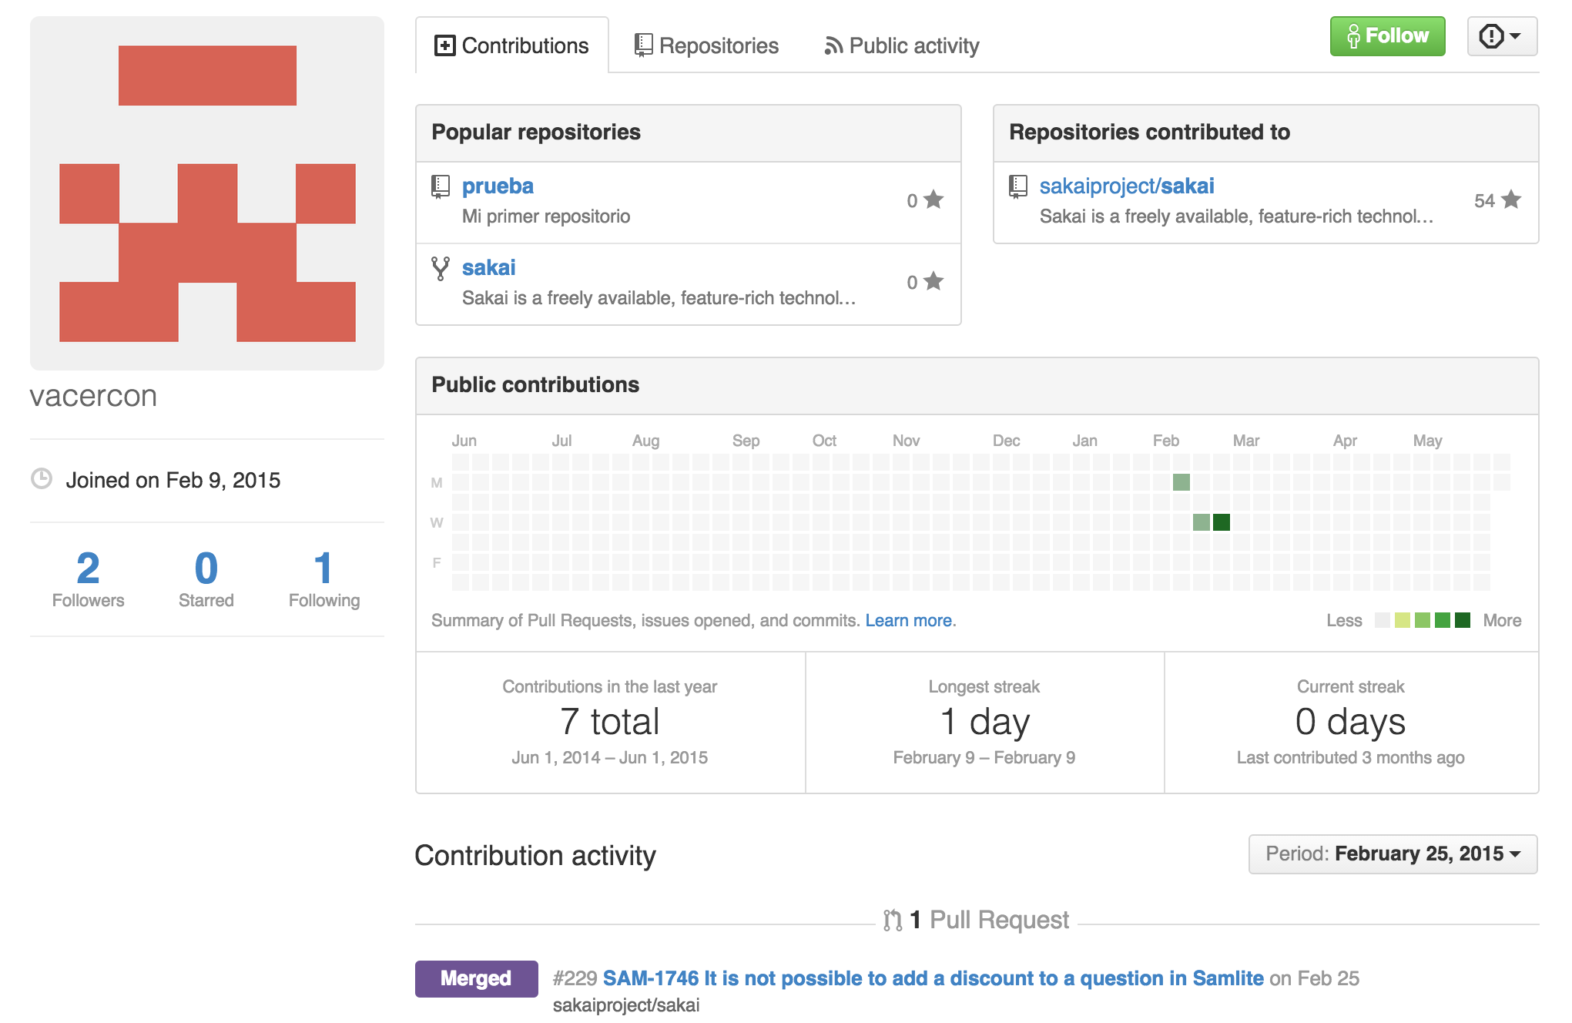
https://github.com/sakaiproject/sakai/graphs/contributors

Slide 26
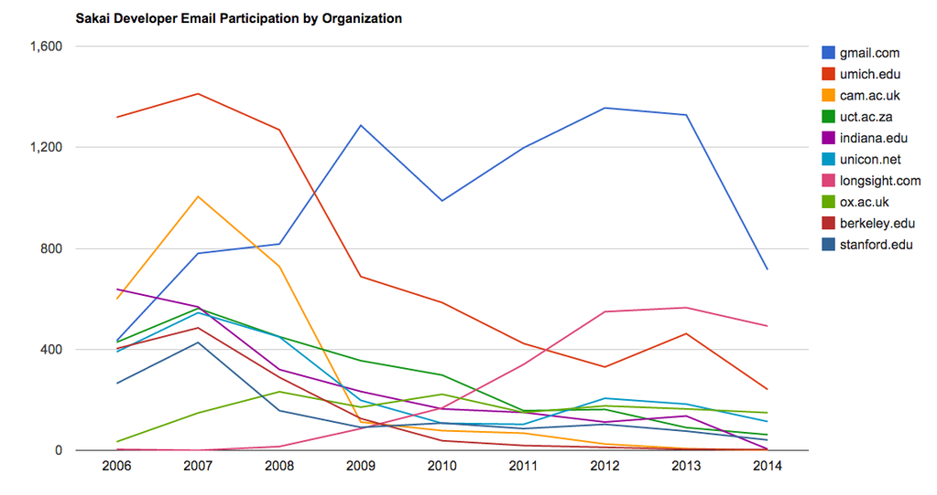

Slide 27



Evolving Leadership
Rutgers
Oxford
NYU
Cape Town
Notre Dame
Duke
Marist
UHUHS
Western University
Texas State
Valencia
Murcia
Navarra
Lledia

Slide 28
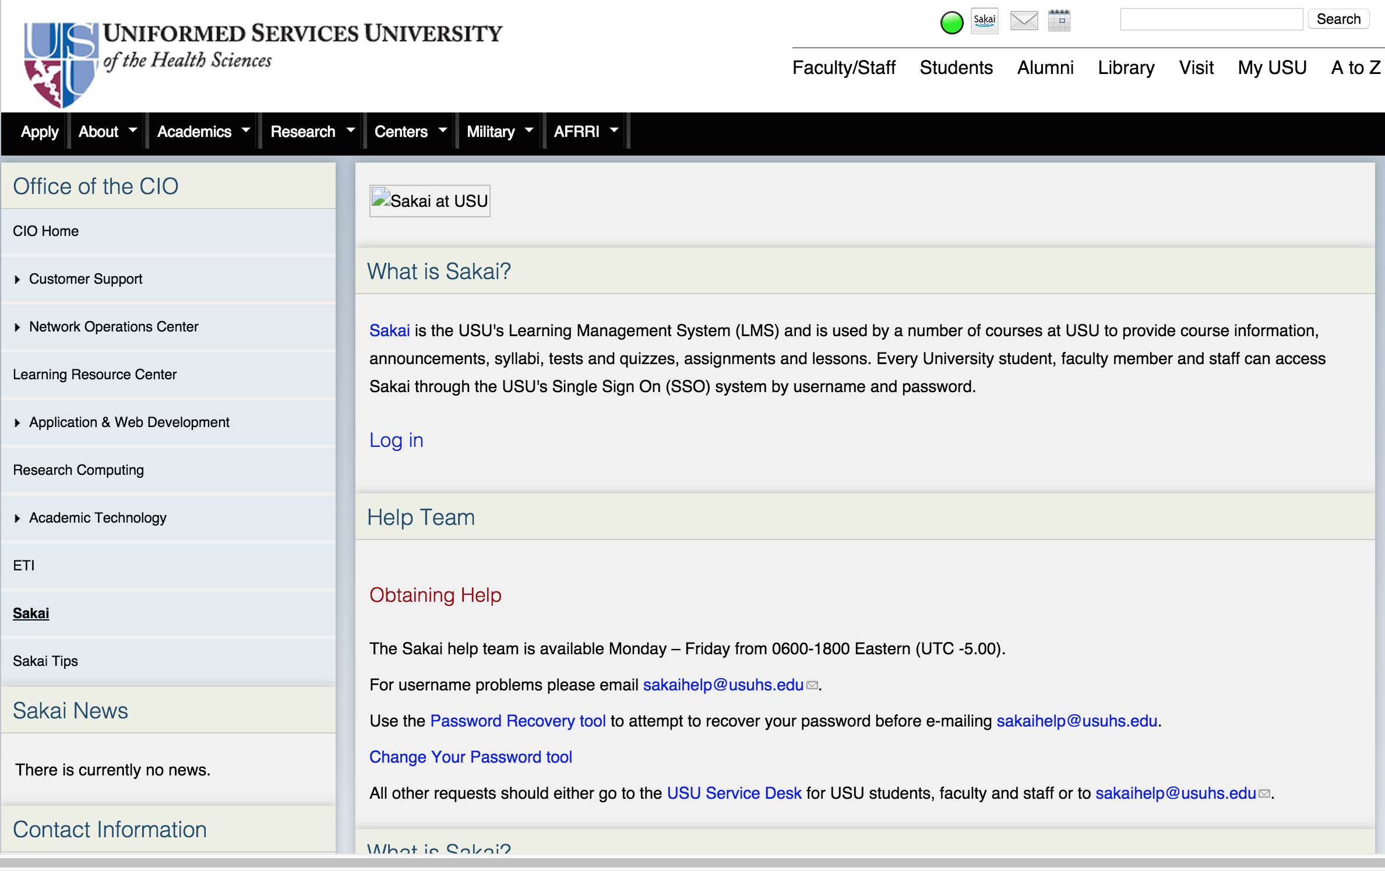

Slide 29
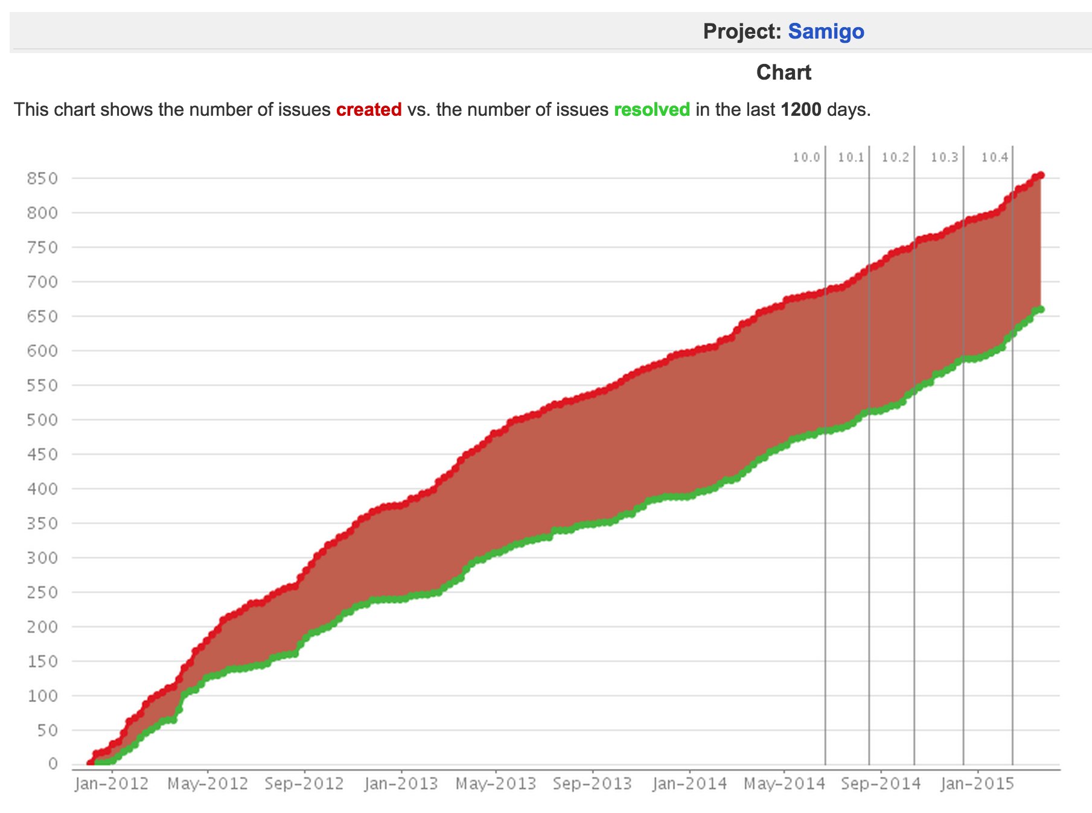

S2U – Sakai
Spanish Users
Transitions

Slide 30
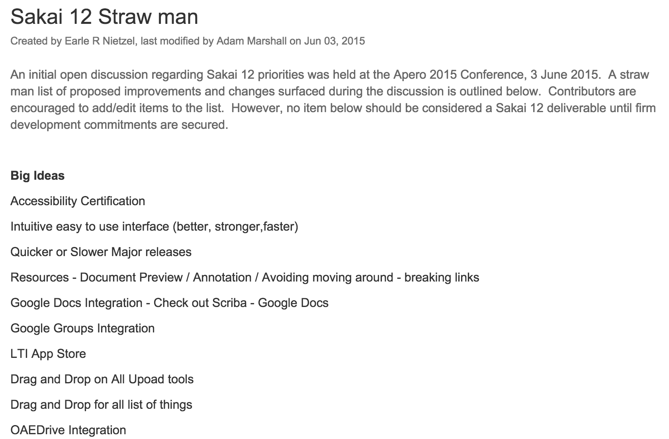
Sakai 12 – Dream Big?
https://confluence.sakaiproject.org/display/REL/Sakai+12+Straw+man

Slide 31
Sakai 12 – Dream Big?
12?
11
2.9
10
2.6
2.7
2.8
2.5
2.0
There has never been a better time to dream big in Sakai.
1.0
1.5

